Slide 1

PROJECT CLOSURE REPORT
CHEMFAB ALKALIS LIMITED
Project : Plant – I Upgradation
Submitted By:
CAL Project Team

Slide 2
Agenda
Purpose and Objective of report
Project Closure
Project Summary
Lessons Learned & Best Practices
  Project Management
  Process Department
  Civil Department
  Mechanical Department
  Electrical Department
  Instrumentation Department
Recommendations

Slide 3
Purpose & Objective of Report
The Project Closure Report is the final document created by CAL team at the end of the project and this step is part of project closure process. This document is part of the Plant1-Upgradation project and it is created by project management team in coordination with project team and various department heads. We continuously discover better ways of doing projects and for that purpose it is necessary that as an organization we perform self-reflection session periodically. Project closure process includes discovery and documentation of the following.
  Archive all the documents of project for future reference purpose
  Formally declare that project is closed therefore no work and cost should be reported in this project
  Release the project team from the “Plant1-Upgradation” project
  All the contractors formally informed that project is being closed
  Review and validate the milestones and overall journey of the project
  Document risk, issues, solution, workaround, suggestion which may affect operation or next related project
  Document lessons learned
  Document Best Practices

Slide 4
Project Closure
Sponsor wanted to close the project because the project is delayed due to Statutory approvals.
Deferred Scope:
  The items like Clarifier, Boiler & Wet Cooling Tower are removed from the project scope as delay in commissioning of these equipment will not affect the commissioning of Plant-I upgradation Project.
  Some of the equipment are not installed as there will not be increase in production considering the current status.
  Installation of some of the critical equipment can be done during complex shutdown of both the plants (Plant – I & II) before commissioning.
Project Resources: The project resources are being released and asked to mobilize during the complex shutdown to complete the final hookup jobs.

Slide 5
PROJECT SUMMARY

Slide 6
Project Statistics
Description | Original Baseline Plan | Actual | Variance
Start Date | 22-Oct-12 | 22-Oct-12 | -
Finish Date | 25-Jan-14 | 01-Apr-14 | +58 Days
Total Duration | 394 Days | 452 Days | +58 Days (+15.2%)(*)
Total Cost (in Cr.) | 48.03 (**) | 35.03 | -13.00(*) (-29%)
(*) Remaining works of the project need : 10.53 Cr. + 1.45 Cr (Details in next slide)
(**) The Project is baselined for 48.03 Cr. excluding the items below:
Clarifier & Accessories | 3.00 Cr.
Harmonic Filter | 0.31 Cr.
TOTAL | 3.31 Cr

Slide 7
Project Statistics
(Rupees in Crores.)
Estimates for Pending activities
Boiler and accessories | 0.43
Painting cost for pipes and structures | 0.16
Mechanical works amendments (Pratheesh + modern + CPP) | 0.13
Electrical works (Statutory) | 0.03
Instrumentation work amendments | 0.01
Civil works (Boiler foundation) | 0.10
Erection & Inspection charges (Cost to Jayam + CEC Engineers) | 0.43
Contingency + Store stock considered | 0.16
TOTAL | 1.45
Original Budget |  | Revised Budget
Baselined | 48.03 | Actual Consumption | 35.03
Estimates for Clarifier + Harmonic Filter | 3.31 | Estimates for Shutdown activities | 10.53
 |  | Estimates for Pending activities | 1.45
 |  | Estimates for Clarifier + Harmonic Filter | 3.31
TOTAL | 51.34 | TOTAL | 50.32

Slide 8
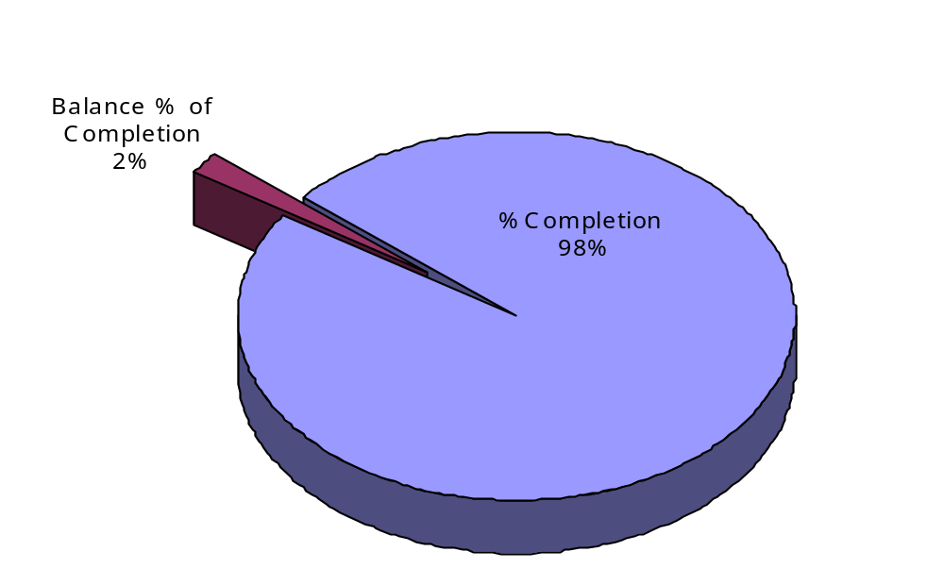
Project Statistics
Percentage Completion | 452 Days (98%)
Remaining Duration | 10 Days (2%)

Slide 9
Project Statistics

Slide 10
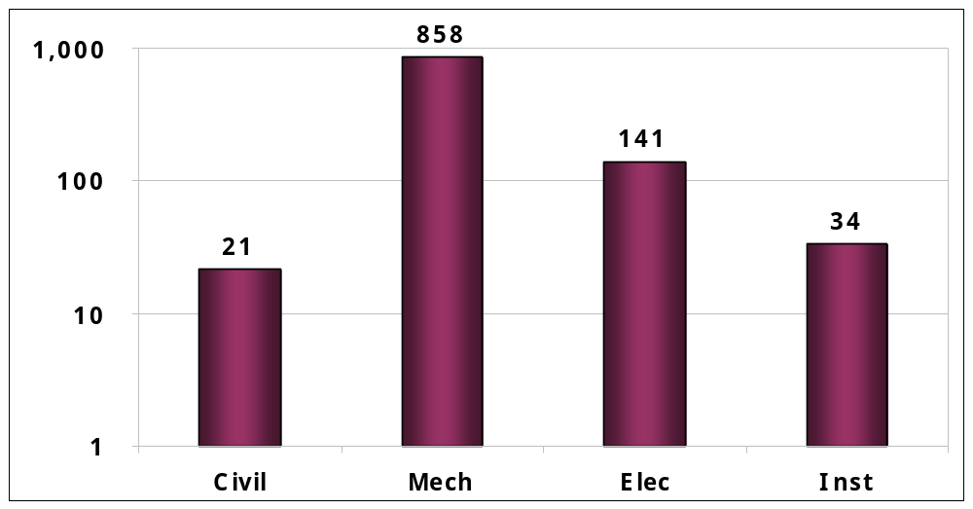
Project Statistics (Pending Work)
(Rupees in Lakhs.)
Dept. | Civil | Mechanical | Electrical | Instruments | Total
Remaining Cost Required | 21.49 | 857.66 | 140.5 | 33.65 | 1,053

Slide 11
PROJECT MANAGEMENT

Slide 12
Highlights
The top management has a serious commitment for better project governance and planning.
Project team members were serious & committed. The learned many new things in the project
The project team saved cost at many places by building new skills
The project management team learned better methods of project planning and governance
Department heads are committed for the project.
PMO was setup to manage projects
Project Management Consultant were engaged to improve project planning & governance

Slide 13
Best Practices
Daily Stand-up meeting organized regularly to understand the day to day progress and impediments in the project. It also improved project communication and team bonding.
Project schedule was created and critical path activities were identified
Operational and Maintenance Flexibility:
  The tanks inside the anolyte pit are designed identically for interchange of tanks (if any situations calls for).
  The MOC for Chlorine wash tower-II is changed from PVC to CPVC for durability of Tanks.
Cost Saving: Before procurement of materials, the existing / non moving stocks from Stores were considered.

Slide 14
Lessons Learnt – Project Management
Problems Encountered | Impact | Recommendations
Delay in getting proper approvals from the Statutory bodies | Delay in execution and commissioning of the project | Document all the approval requirements and analyze. Identify all internal & external Stakeholders. Obtain the commitment for all required approvals. Develop stakeholder management strategy.
Project scope and boundary was not clearly defined before start of the Project | Delay in execution of the project | Develop project vision Brainstorming sessions to define project boundary Develop Project charter Develop Scope management Plan Develop Requirement Management Plan

Slide 15
Lessons Learnt – Project Management
Problems Encountered | Impact | Recommendations
Traceability and duplication of project documents | Time waste in searching documents Sometimes latest documents are not available Use of supersede / void documents | Establish the configuration Management plan at PMO and Project level. Create Directory structure and document name and versions as per configuration management plan. Provide access to the project documents as per the Configuration management plan. Take periodic backup and validate the restorage of project documents.
Assumptions & constraints in scope of work and Open ended decisions found throughout of the project | Confusion in scope of work and delay in execution of the project | Assumptions, Constraints and Dependencies (ACD) should be thoroughly discussed and documented. Risk register should be developed using ACD. Risk Management strategies should be established. Risk items and Risk Management strategies in risk register should be monitored and control throughout the project life cycle.

Slide 16
Lessons Learnt – Project Management
Problems Encountered | Impact | Recommendations
Project monitoring and reporting systems were loosely defined | Difficult to know the actual project status on any day. | Establish the reporting structure and report formats. Collect the project progress data regularly. Periodically analyze data and prepare reports to share with stakeholders. Periodically analyze sufficiency and effectiveness of reports.
Improper communication about procurements between project, purchase, stores and user depts. | Store / user dept. does not know the material procured is as per scope of supply or not. User dept. conducts inspection as per the Delivery challan and not as per the PO. | Purchase Dept. must share released PO copies to stores, user depts. and Projects. Procurement need to be done using Item codes

Slide 17
Lessons Learnt – Project Management
Problems Encountered | Impact | Recommendations
Some of the contracts are given to in-house contractors. | Delay in job execution. | Vendor Evaluation criteria should be clearly defined. Award the contracts only to those vendors who fulfill the Evaluation Criteria. Penalty/ Reward Clauses in contract should be made in such a way that motivates vendor. Ask contractor his execution plan and incorporate this plan into our Master Plan Call all vendors for Final project planning meetings and share the dependencies of activities between vendors . Monitoring & Controlling System of Contracts procurements should be established, agreed with contractor and implemented through out the contract period.

Slide 18
PROCESS DEPARTMENT

Slide 19
Highlights
Concept of introducing 3rd Ion Exchange Column was conceived and executed by CAL team.

Slide 20
CIVIL DEPARTMENT

Slide 21
Highlights
Uninterrupted Operations:
  Extension of anolyte pit carried out without disturbing the existing plant operation. The wall between old and new pit was demolished by providing the temporary arrangements.
  Extension of Diesel Generator shed has been carried out and completed without disturbing the existing setup for providing MCC-3 panel and DG auxillary panel.
  The existing pipe rack foundation and QC Lab foundation fouled with the new pedestal of Cl2/H2 Structure. The same were modified to suit the site condition within very short span of time.
Technical capabilities by CAL:
  The civil works related to IEC, pump beds, electrical dept activities, clarifier flooring were planned and executed by CAL Team.

Slide 22
Best Practices
Improved Operational Efficiency:
  Corrosion Resistant Steel and Sulphate Resisting Portland Cement were used for the construction of Clarifier, Cell house and Rectifier foundations and buildings where the atmosphere itself is more corrosive .
Safety:
  To protect the adjacent structures, we used shoring and side embankment during the time of deep excavations near anolyte pit and Cl2/H2 area.
  The existing pipe rack foundations and QC Lab foundations fouled with the new pedestals of Cl2/H2 Structure. The same were modified to suit the site condition within very short span of time.

Slide 23
Lessons Learnt – Technical
Problems Encountered | Impact | Recommendations
Mass excavation done during the Rainy season | All excavated pit were filled with Rain water and delayed the project schedule | Consider climatic conditions in our risk register. Contingency plan should always be ready to avoid such situations.
The existing underground utility system drawings like underground cables, pipelines were not available | The existing underground utilities delayed the schedule of the project. | The Existing underground system should be made ready before start of the excavation.

Slide 24
MECHANICAL DEPARTMENT

Slide 25
Highlights
Re-Utilization:
  Procurement of new EOT Crane for cell house was avoided by changing the methodology in removal of elements from Electrolyzer.
  Utilized the unused / old sulphuric acid tank as new chilled water tank with minor modification.
Technical Capability of CAL:
  CAL Team completed the engineering, procurement and execution of 3rd IEC.
  Erection of UF Feed Tank is well planned and executed with temporary arrangements with out disturbing the existing plant operation.
Cost Saving by CAL team:
  Gasketing of Electrolyzer was done with our technicians / manpower along with the CEC Engineer without opting for subcontractors.
  Strengthening of Existing Pipe rack BOQ was reduced by CAL’s alternate design with the help of TEAM which is vetted by Dr. V.
  Lichlor cooling Tower – Utilized the existing cooling water return header to hookup the cooling water from Chlorine / Hydrogen section
Environmental Initiative:
  Erection of Chiller done manually to avoid cutting of trees for crane movement.

Slide 26
Best Practices
Uninterrupted Operations:
  Erection of structures in running plant without disturbing the existing setup like strengthening of existing pipe rack, proposed pipe rack, platform at Plant-I OHT area, Hypo OHT area and pipe racks at various locations for routing new pipelines.
  The erection of Polished Brine Tank and Pure Brine Tank were done without disturbing the existing plant operations .
  Erection of Saturator was well planned and erected using 4 hydra cranes (synchronized movement) without disturbing the movement of JCB to feed salt to the existing saturators.
Technical Capability of CAL:
  Chlorine condensate transfer pump was proposed by CAL Team during engineering stage for smooth and better operation.
  The alternative locations for Hypo and 78% H2SO4 pumps & coolers were identified and major activities carried out to avoid the disturbance in the existing setup.
  The loops in the piping routes were avoided by changing the elevation and pipe route in the pipe rack.
  Originally the pipes for cell house were planned to erect inside the trenches. CAL Team have reviewed the details in maintenance point view, the pipes in trenches were avoided.

Slide 27
Lessons Learnt – Technical
Problems Encountered | Impact | Recommendations
Erection of Secondary Pipe supports were not in the scope of Piping contractors. | Delay in execution and improper fixing of piping supports | Fixing of Primary & secondary supports should be a part of Piping contractor scope.
Electrical cable trays in Pipe rack were not available in the overall drawing. | Delay in execution of the project | All department requirements should be consolidated and incorporated in consultant drawings. Review the consultant drawing in overall project perspective and Discuss with consultant for co-ordination of all departments requirement.

Slide 28
ELECTRICAL DEPARTMENT

Slide 29
Highlights
Technology Upgradation:
  Rectification by ABB Thyristor controlled rectifier unit with PLC control which can be remotely operated through DCS.
  Siemens IE2 motors installation improves Energy saving.
  HT panels installed with ABB Vacuum circuit breakers helps in improving reliability.
Cost Saving:
  The reduction in Bus bar cost by eliminating R-202 bypass.
Uninterrupted Operations:
  Planning, Erection of MCC 1 & 12 were lined up in Plant running condition without disturbing the existing setup.
  Temporary needs are identified before replacing the existing MCCs.
Operational and Maintenance Flexibility:
  MCC layout in DG Area was revised for MCC-3A panel.
  Standardization of Switch gears by replacing all PCC and MCC panels with Siemens make – Better spare management.

Slide 30
Best Practices
Operational Efficiency:
  Improved Energy consumption monitoring by providing Multifunction meter at out going feeders of Main PCC.
  Faster Trouble shooting by laying Power & control cables in separate cable trays.
  Improved work environment by Installing Local Push Button Stations close to the Motors and neatly dressed of cables.

Slide 31
Lessons Learnt – Technical
Problems Encountered | Impact | Recommendations
Insufficient Temporary lighting and power source for construction activities | Delay in schedule / execution of the job. | Temporary power requirement to be planned by user departments. Tentative requirements to be informed in advance. Spare Light fittings to be planned.
Generation of Induction Voltage in all MCCs | Delay in hooking up feedback to DCS panel | Coordinate with other departments and incorporate the requirements at the time of placing PO.

Slide 32
INSTRUMENTATION DEPARTMENT

Slide 33
Highlights
Improved Operational Efficiency:
  By Integration of both the DCS so that all the plants can be operated from new DCS.
  By providing magnetic flow meter for New Kirloskar Chiller and the existing Dunham Bush chiller and indication hooked up to DCS.
  Adequate signal cabling provided from Rectifier Panel to DCS (Both analog & digital)
Technical Capability of CAL:
  Configuration of IEC 3 tower set up done in new DCS.
Cost Saving:
  New Filter press instrumentation erection was carried out using Instrument erection Contractor and in-house resources.
Safety:
  By providing vibrating type density analyzers for Caustic in place of Nucleonic device, the Radiation safety hazard is eliminated.

Slide 34
Best Practices
Increased System Efficiency by using 1 GBPS DCS.
Increased Reliability by using Magnetic flow meters with 3 electrode instead of 2 electrode design.
Increased Process Safety by following the concept of ‘Break to Alarm’ instead of ‘Make to Alarm’ philosophy.
Improved Accuracy by using Magnetic / Vortex flow meters instead of orifice plate + DPT.

Slide 35
Lessons Learnt – Technical
Problems Encountered | Impact | Recommendations
Diaphragm type pressure gauges were not as per CAL standard (2”) | Delay in installation of Pressure gauges | Consultant drawings to be reviewed with respect to CAL standards.
Level transmitters HP & LP flange sizes were not equal for some of the Transmitters. | Delay in fixing the Transmitters and incurred additional expenditure in fabricating the distance pieces. | Use same size of flanges for LP and HP as a standard practice.
Colour of Alarm cable opted for Black. | Alarm & Power cables of same size could not be distinguished due to same colour. | Colour code for cables to be finalized. Signal Cable – Blue Power Cable – Black Alarm cable - Grey

Slide 36
RECOMMENDATIONS

Slide 37
Other Important Recommendations
Active participation of all department is required in estimation, scheduling and assumptions documentation. Project team have to continue regular stand-up meetings to address this daily issue and improve project communications.
Skill of Vendor Supervisor: We must ensure that contractor has deputed supervisors who should have a minimum 5 years of experience in similar type of construction works.
Monitoring and reporting system: Regular meeting of all departmental heads should help in surfacing issues. Every impediments should have SLA time and should be managed very closely. Minutes of each meetings should be documented.
Greater reliability: For all trip loops, we have to consider a separate Emergency Shut down (ESD) system rather than configuring the trip logics in DCS. As a concept, the Plant process control system (DCS) and the ESD system (a PLC) are to be different and physically separated. This will ensure greater reliability. In that event, we have to consider separate field instruments for the ESD system and DCS. This will be expensive initially but very safe in the long run.
Dedicated team required for project coordination and follow ups and holding responsibility / accountability.
All material procured should be systemized and all the issue of materials are regularized with proper material code. This will ensure real-time stock availability of construction materials.

Slide 38
THANK YOU

